Slide 1
Protective Behaviours
A personal safety program for children
Notes:
Thank you for joining us today at Wide Bay Trauma Assist to engage in learning about Protective Behaviours, My Body My Rules!
Before we start we would like to acknowledge the Traditional Owners of country throughout Australia and the land we meet on today belonging to the local Butchalla people, we recognise their continuing connection to land, waters and culture. We pay our respects to their Elders past, present and emerging.

Slide 2
Protective Behaviours My Body Safety Rules
Week 1
Introductions/Group Agreement & Confidentiality
My Body is my Body and it belongs to Me!
Feelings & Early Warning Signs!
Week 2
Traffic Light Model
I have a safety network
Secrets & surprises!
Week 3
Private Parts!
Internet safety
Recap & Quiz
Notes:
We are going to break these areas down over 3 weeks

Slide 3
Group Agreements & Confidentiality
Be nice to one another
Keep your hands to yourselves, use your words
Everyone can have a turn at speaking
Consent & Confidentiality
This is a private group whatever we talk about stays here, but if you tell me you or someone else is being hurt I may have to tell someone to protect you
This is a safe space ☺
Notes:
Discuss consent & confidentiality – ensure everyone understands what this means
Group Rules ( draw them up on butcher paper/board if people want to add more)

Slide 4
My Name is ………………………………………………………….
I am …………………………………………………..years old!!!
This book belongs to me ☺
Draw your face here
Notes:
Ask participants to draw a picture of themselves & complete the details. (print this for book)

Slide 5
My body, My Rules We all have the right to feel safe, all of the time! Protective Behaviours relates to keeping our body safe & talking to a safe adult if we don’t feel safe. We have the right to feel safe We have the right to tell someone if we do not feel safe
Notes:
We are all born with the right to feel safe all of the time, this is a natural human right and should apply to all people regardless of their age, if they are boys or girls and the colour of their skin
Does anyone know what we mean when we use the words – protective behaviours?
Protective Behaviours are life skills we learn which we use to keep ourselves safe. We are not born knowing these skills but we can learn them, it is important that we develop these skills and learn to recognise when we feel safe or unsafe and what we can do about it.

Slide 6
My Body Safety Rules
https://www.youtube.com/watch?v=u03EHVf-7vI
Notes:
We are going to watch a video now which will explain more the areas we are going to talk about over this programme.
After Video give my Body safety Rule handout

Slide 7
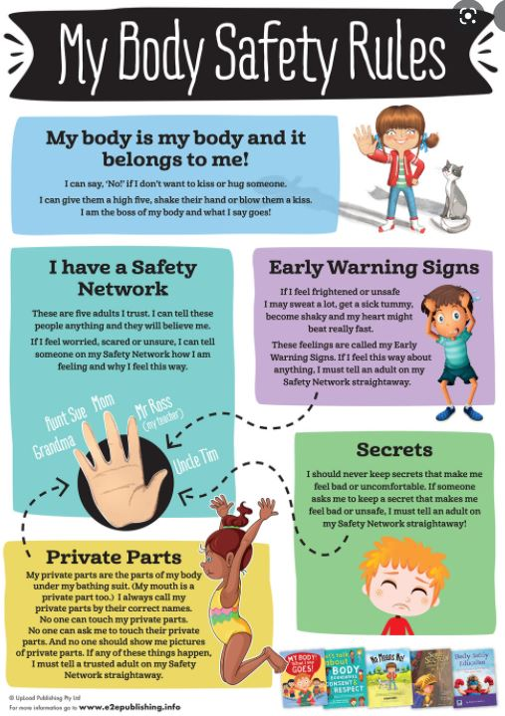
You have a copy of this
slide in your folder to keep.
☺
Notes:
Give handout & discuss this week we will be concentrating on
My Body is My body and it belongs to me!
And I have a safety network.

Slide 8
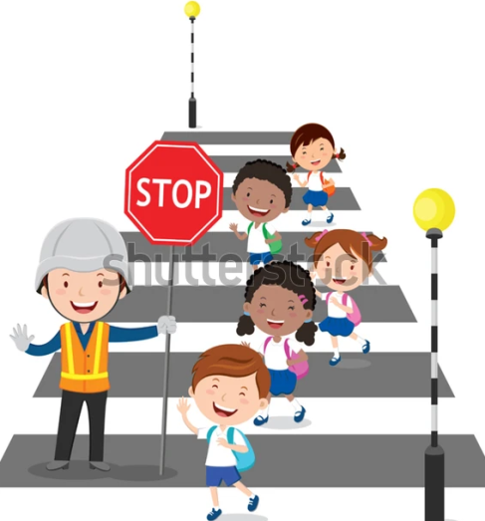
It should be just as normal for adults and children to have conversations about feeling safe & keeping our bodies safe as we do about safely crossing roads.
Notes:
Can we talk about some times that we need to think about being safe?
What might we do when we get in a car to be safe?
What might we do if we ride a bike or a scooter to keep ourselves safe?
Have you ever had a conversation about your own body and how you might keep that safe?

Slide 9
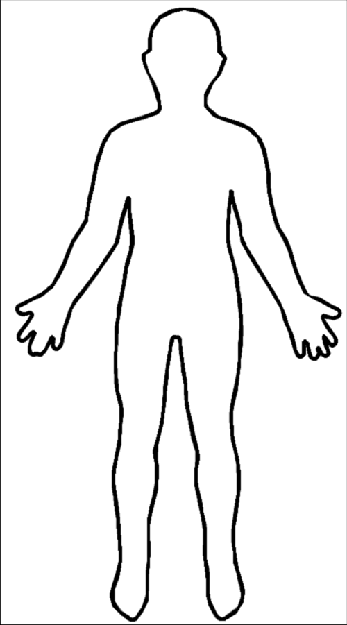
My Body is my Body and it Belongs to Me!
This is
……………………………….
Body!
What I say GOES!!!
Draw yourself on this body

Slide 10
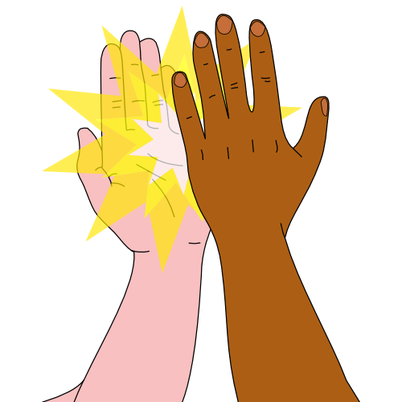
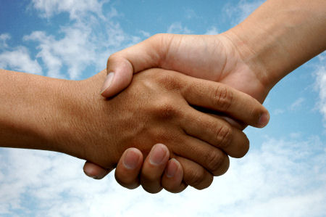
Consent video
https://www.youtube.com/watch?v=h3nhM9UlJjc
If you don’t want to kiss or hug someone, what could you do instead?
Notes:
Watch kids consent video
Ask the children to talk about what they feel comfortable with. Ask them to discuss what they could do instead of a kiss or a hug

Slide 11
Feelings & Early Warning Signs
Everyone has different feelings.
Our feelings are important.
When I am happy I feel ………………………………………………
……………………………………………………………………………………..
………………………………………………………………………………………
When I am sad I feel ………………………………………………
………………………………………………………………………………..
………………………………………………………………………………..
When I am angry I feel ………………………………………………
…………………………………………………………………………………….
……………………………………………………………………………………..
Notes:
Print this page for booklet
When I am happy I feel …
Ask group to discuss how they know they are happy & how & where they feel that in there body….

Slide 12
Feeling Safe or Unsafe?
When I am safe I feel …………………………………………………
……………………………………………………………………………………..
……………………………………………………………………………………..
Do I know what feelings I feel when I don’t feel safe?
https://youtu.be/QE_EbWA4vBM

Slide 13
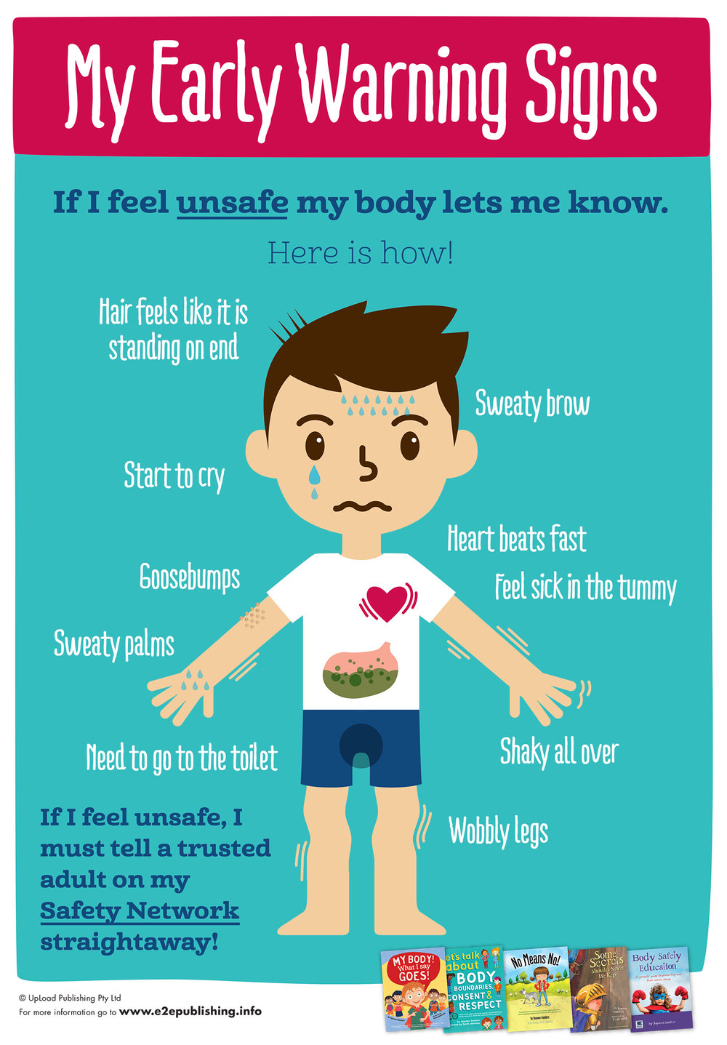

Slide 14
This is …………………………………………
When I don’t feel safe I feel
Notes:
This is homework – children can bring this back next week

Slide 15
Trace over the words and decorate the poster!
REMEMBER
IF you feel any of your
EARLY WARNING
SIGNS
tell an adult
STRAIGHTAWAY

Slide 16
End of Week 1
Thank you & Stay Safe

Slide 17
Week 2 Traffic Light Model I have a safety network Secrets & surprises!

Slide 18
Feeling safe / unsafe
Using Traffic Lights
Unsafe- I just don’t feel safe
Unsure- I’m not really sure how I feel about this
Safe- I think this is safe

Slide 19
The traffic light model is a really quick way we can demonstrate how we feel?
What do we think the red face is??? Are they happy? What about the other faces???
If a stranger asked them to come back to my car & look at my puppies…. Do you think that is safe? What would you do?
If someone asked you to do something and it made you feel nervous, or sick in your tummy or shaky what might that be telling you? Do you think we should listen to those early warning signals?
I am a teacher and I ask you to go and take something to the principals office?
We are good friends and I ask you if you want to come to my house to watch a movie on the weekend? Is this safe… what could we do to check this.

Slide 20
My body, My Rules We all have the right to feel safe, all of the time! Protective Behaviours relates to keeping our body safe & talking to a safe adult if we don’t feel safe. We have the right to feel safe We have the right to tell someone if we do not feel safe
Notes:
We are all born with the right to feel safe all of the time, this is a natural human right and should apply to all people regardless of their age, if they are boys or girls and the colour of their skin
Does anyone know what we mean when we use the words – protective behaviours?
Protective Behaviours are life skills we learn which we use to keep ourselves safe. We are not born knowing these skills but we can learn them, it is important that we develop these skills and learn to recognise when we feel safe or unsafe and what we can do about it.

Slide 21
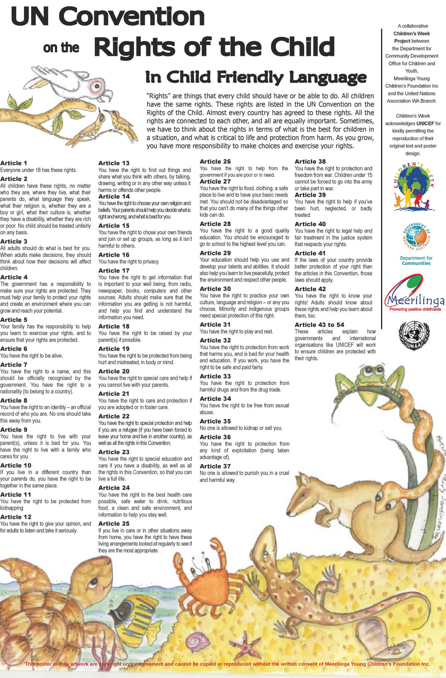

Slide 22
My Safety Hand Network
https://youtu.be/ynkyPHWmbQM
Kids helpline
https://kidshelpline.com.au/

Slide 23
…………………………… Safety Network
My Safety Network people will listen to me, believe me and do something to help me!
Kids Helpline – 1800 55 1800 https://kidshelpline.com.au/
Police - 000

Slide 24
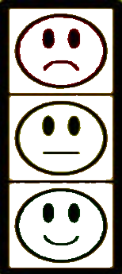
…………………… - I just don’t feel ……………….
…………………… - I just don’t feel ……………….
…………………… - I think is ……………………….
NO GO TELL
If you don’t feel …………….. Say or show NO
Be assertive if you can, then GO to a safe place with other people
And TELL an adult
you trust

Slide 25
Does anyone know what is different between a secret or a surprise????
Secrets & Surprises
You see a classmate stealing something out of another childs bag, they come up to you and tell
You not to tell the teacher or something bad will happen…..
Is this a secret or a surprise
Is it ok to tell????
You are out shopping with
Your Nan & she buys a present for your Mum’s birthday. Nan asks you not to tell, is this a secret or a surprise?
Is this ok to keep to yourself until Mum gets her present????
Your friend tells you her Mum’s boyfriend keeps kissing her & giving her really long hugs, she tells you it makes her feel funny in the tummy and she does not like it, your friend said he told her not to tell, it’s their secret.
Is this a secret or a surprise?
Should you & your friend tell someone? Who??
Your Mum is planning a birthday party for your brother, Mum tells you not to tell him? Is this a secret or a surprise?
Is it ok not to tell your brother?
When you visit a friend, they ask you to play a game where you take off all of your clothes, they tell you not to tell.
IS this a secret ot a surprise?
Should you tell someone?
https://youtu.be/mBZ8kSYRCC8

Slide 26
Secrets vs Surprises
Is it a secret or a surprise if we can never tell someone?
Thinking about it makes us feel happy & excited, is it a secret or a surprise?
If someone tells us something bad will happen if we tell, is it a secret or a surprise?
Thinking about it makes us feel mad or sad or scared? Is it a secret or a surprise?
We only have to keep quiet about it for a short time & thinking about it doesn’t feel horrible?
Is it ok for adults to ask children to keep secrets?

Slide 27
What was the best surprise you ever had or the best surprise you could imagine? ………………………………………………………………………………………………………………………………………………………………………………………………………………………………………………………………………………………………………………………………………………………………………………………………………………………………………………………………………………..
Draw a surprise here
Notes:
Ask participants to draw a picture of themselves & complete the details. (print this for book)

Slide 28
Quiz
Is it ok to say NO to a grown up?
If a grown up tells me to keep a secret, do I have to?

Slide 29
End of week 2
Questions?
Homework is your surprise pic ☺

Slide 30
Week 3
Private Parts
Body Bubble
Internet Safety
Recap & Quiz
Feedback form

Slide 31
https://youtu.be/zNTUMNKSNwk
IUNsafe safe touches – prvate parts

